Slide 1
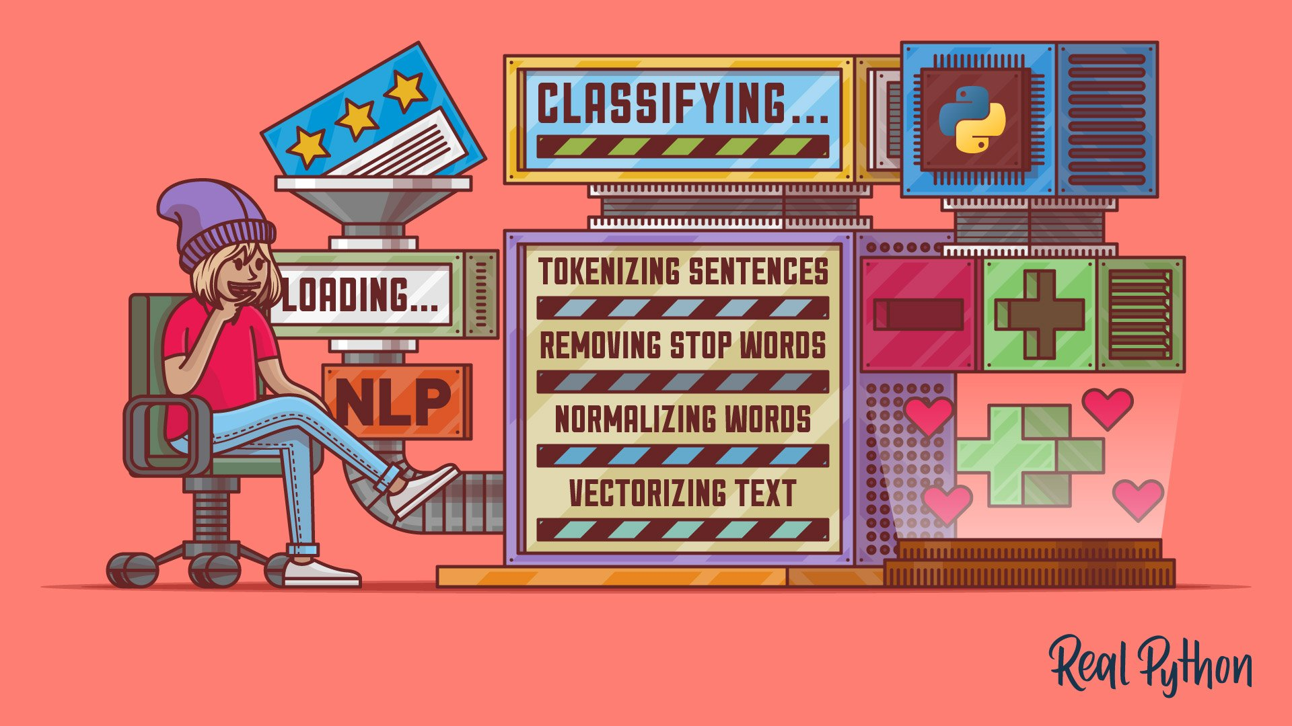
RATINGS PREDICTION PROJECT
Submitted By :
Abhimanyu Varpe

Slide 2
Contents
Problem Statement
Data Analysis
Pre Processing Pipe Line
Conclusion

Slide 3
Problem Statement
We have a client who has a website where people write different reviews for technical products. Now they are adding a new feature to their website i.e. The reviewer will have to add stars(rating) as well with the review. The rating is out 5 stars and it only has 5 options available 1 star, 2 stars, 3 stars, 4 stars, 5 stars. Now they want to predict ratings for the reviews which were written in the past and they don’t have a rating. So, we have to build an application which can predict the rating by seeing the review.

Slide 4
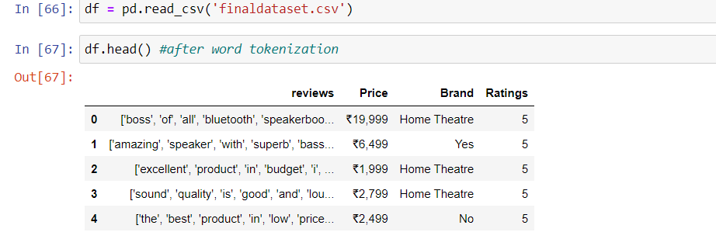
Data Analysis
Dataset contains 20000+ rows and four columns
Will use only reviews as a independent feature

Slide 5
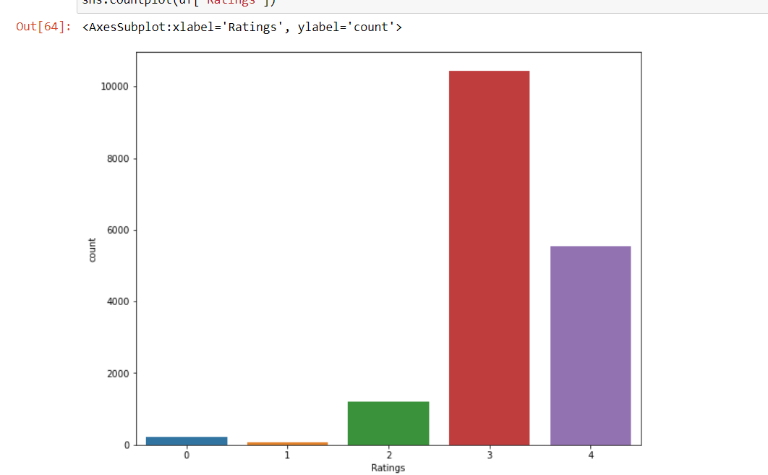
Ratings: Label
First I have converted Ratings to the float datatype and then
Round off that ratings from 1 to 5

Slide 6
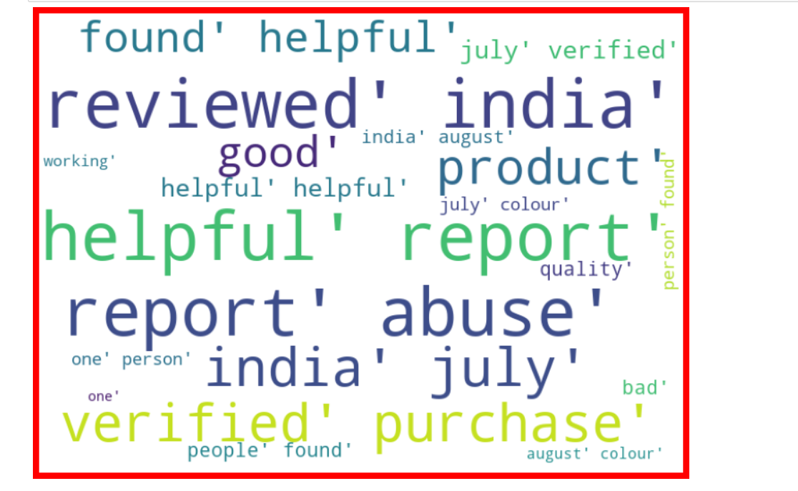
Word Cloud:
Top 20 frequent words in the reviews with label = 1

Slide 7
Pre-Processing Pipe Line
Following Steps for Pre processing of data:
1. Converting to lower case
2. Remove stop words
3. Word lemmatization
4. Spelling correction
5.Remove emoji's
6. Remove numbers
7. Remove single character
8. Treat Null values

Slide 8
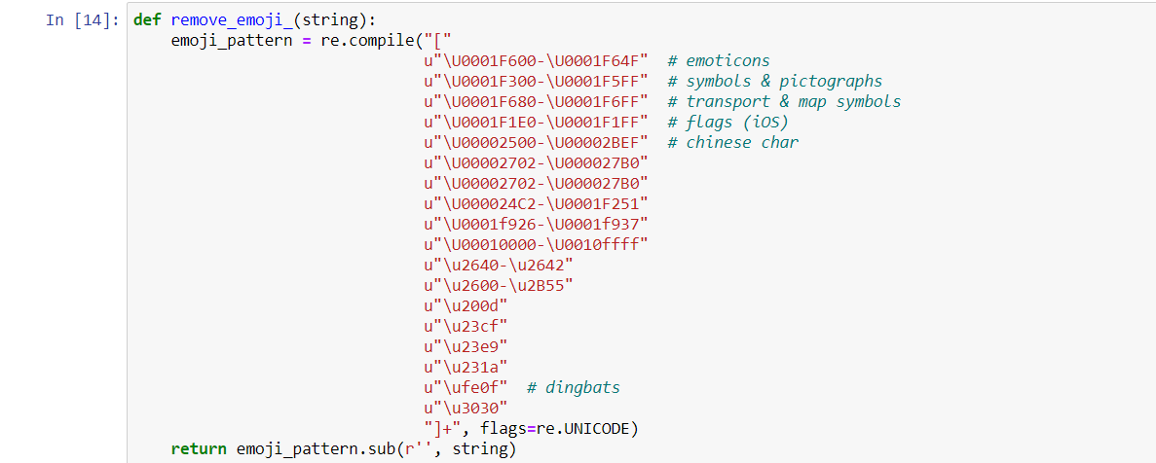
Some Functions for Pre Processing
Remove Emoji's:

Slide 9
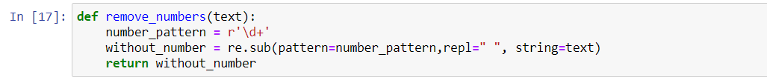
Conti…
2. Remove Numbers:

Slide 10
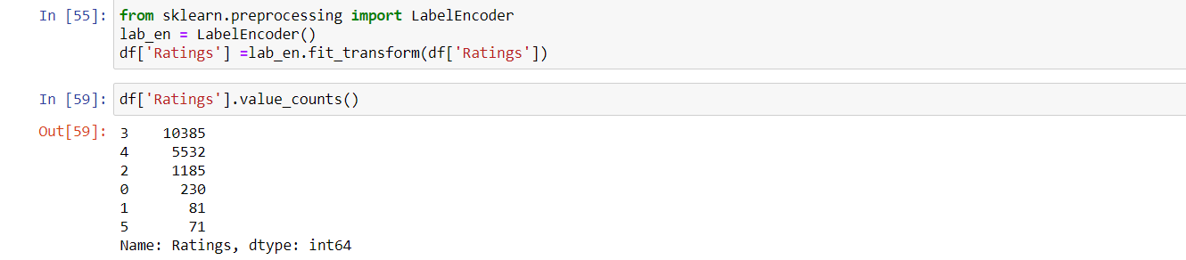
Label Encoding
Label Encoding Of Ratings:

Slide 11
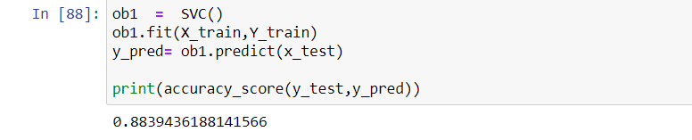
Best Working Model: SVC Model: Accuracy = 0.88

Slide 12
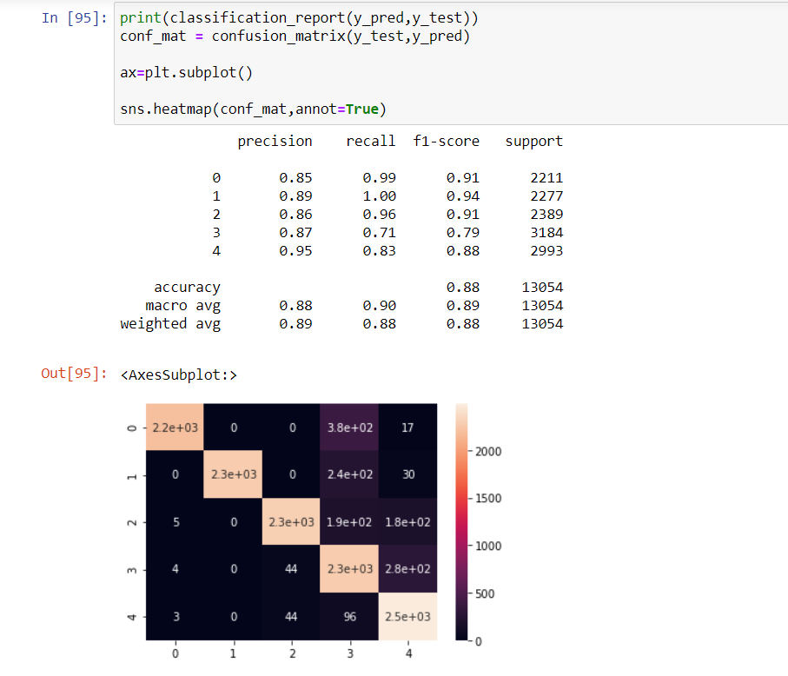
Metrics of SVC:

Slide 13
Conclusion:
Collected Data from different websites like : amazon , flipkart , paytm , digit, snapdeal.
Products for which data is fetched : Mobile phones , Laptop , Monitor ,
Headphones , Camera , printer etc.
Used Various method of Natural Language processing to pre process the data .
Used Four Machine Learning Algorithm :
MultinomialNB , SVC, DecisionTree, KNN.
To Handle unbalanced label used oversampling.

Slide 14


